Slide 1
Software QA and Testing with Automation using Selenium IDE Course 1, Class 5
Instructor
David F Wagoner
PMP, CSQE, CMQ/OE

Slide 2
The Big Picture
Think back to our first class and the discussion on ‘What is Quality? What does it mean?”
We learned it is based on conformance to requirements, SDLC processes and low level of defects and it’s usable

Slide 3
Quality and Maturity Models
Quality standards (e.g. ISO 9001) and capability maturity models are ways organizations can focus on instituting quality systems and processes within their organization and evolve them continually over time?

Slide 4
Why use Quality Models?
Think of yourself as a customer with $10 million to spend on software for your company
How do you look inside a stranger's house and judge their capability to develop a system?
When you look at vendors, all who claim to be the best in the industry and have similar costs, how would you know which one to use?
You use the one that is going to deliver the system on time, with few defects, conforms to YOUR requirements, and whose system is reliable
How do you know which one can do this?
You’re not looking for these qualities in your own company, you’re looking at these in another company strange to you and whom you have little to no knowledge beyond what their marketers spew

Slide 5
Quality Models
One way is to understand the importance of having a process-focus on the SDLC and then having appropriate quality management in place in the vendor company
Quality models help to accomplish this by:
Guiding a vendor’s implementation
Having an external third party hired by the vendor, ensure these elements are all in place, are actively used and are continuously improved

Slide 6
Current Models
The standards developed by the International Organization for Standardization (ISO)
ISO 9001 and ISO 20000 are the most commonly used in our industry
These are derived from older manufacturing quality models
The maturity capability models initially developed by The Software Engineering Institute at Carnegie Mellon

Slide 7
ISO
ISO 9001 is a standard for establishing a Quality Management System
Define elemental business and engineering processes including resources acquisition and product integration
Define an upper level management group for oversight of quality goals, initiatives and processes
Define audits and reviews to verify quality activities occur as planned
Support Semi-annual, annual or tri-annual recertification

Slide 8
CMMI
Development of CMMI was sponsored by DoD to address The Software Crisis
Over 86% of software projects failed, either by not delivering, being cancelled, not meeting functional and performance requirements and a host of other reasons
A man named Watts Humphrey and his team adapted tried and true quality principles to software development

Slide 9
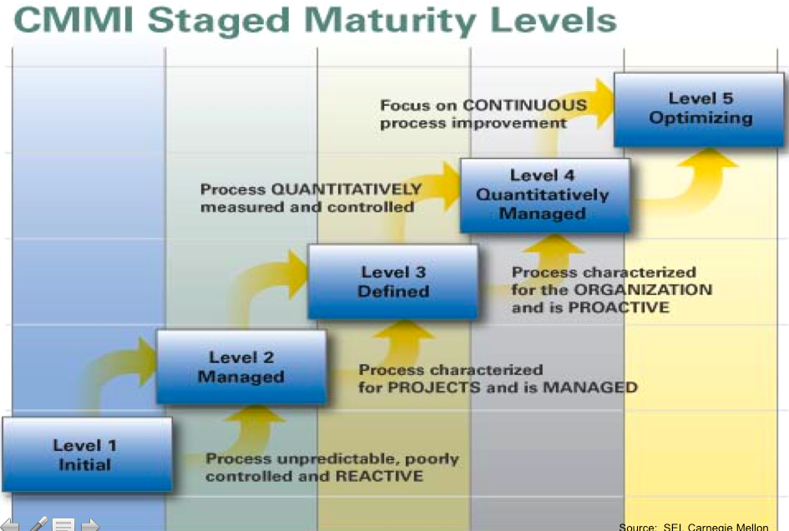
CMMI Levels

Slide 10
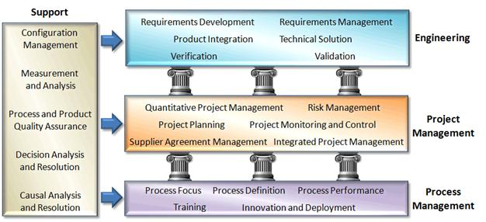
CMMI Process Areas

Slide 11
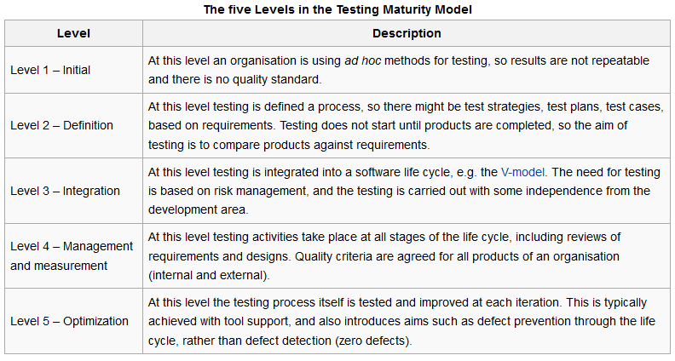
Testing Maturity Model
Source - Wikipedia

Slide 12
TMMi Level 2 Definition
The process areas at TMMi level 2 are:
Test Policy and Strategy
Test Planning
Test Monitoring and Control
Test Design and Execution
Test Environment

Slide 13
TMMi Level 3 Integration
The process areas at TMMi level 3 are:
Test Organization
Test Training Program
Test Lifecycle and Integration
Non-functional Testing
Peer Reviews

Slide 14
TMMi Level 4 Measured
The process areas at TMMi level 4 are:
Test Measurement
Product Quality Evaluation
Advanced Peer Reviews

Slide 15
TMMi Level 5 Optimized
The process areas at TMMi level 5 are:
Defect Prevention
Quality Control
Test Process Optimization

